Slide 1
Microsoft Data Analysis
In the slides above I am presenting methods I used to analysis data for Microsoft

Slide 2
Microsoft
They wanted to start movie production. So they wanted analysis of the following files to get a stepping stone where to start from

Slide 3
The files provided for data analysis :
1.RT.REVIEWS.TSV
2. RT.MOVIES.INFO.TSV
3. MOVIES.CSV
4. MOVIES_BUDGET.CSV
5. MOVIE_GROSS

Slide 4
I choose the following files to start my work
RT.REVIEWS.TSV
MOVIES.CSV
MOVIES-BUDGET.CSV

Slide 5
WORK PROCEDURE
1) I strated my work with converting the files into dataframes.
eg movie_budget.csv to movie_budgetcsv_df
A data frame is a structure that organizes data into a two dimensional tasble of rows and columns.
From there I printed the output to check my organized structure

Slide 6
PROCEDURE TWO:
I conducted data cleaning to erase
-duplicates
- remove the incomplete data types
-remove the missing files.
-remove undesired formats
- this enhances data accuracy while analyzing data.

Slide 7
QUESTIONS
I set my work into questions for easy understanding and flow of work.
I used the rt_reviews_df
It contained columns like;
‘publisher’, ’ratings,’ ‘release data’ and ‘reviews’
:The question answered the below arguments:
I used the question to calculate the reviews of each publisher ,
from there i used data visualization by using a scatter graph to show the relationship between release date and rating . the last question was counting the number of ratings. –

Slide 8
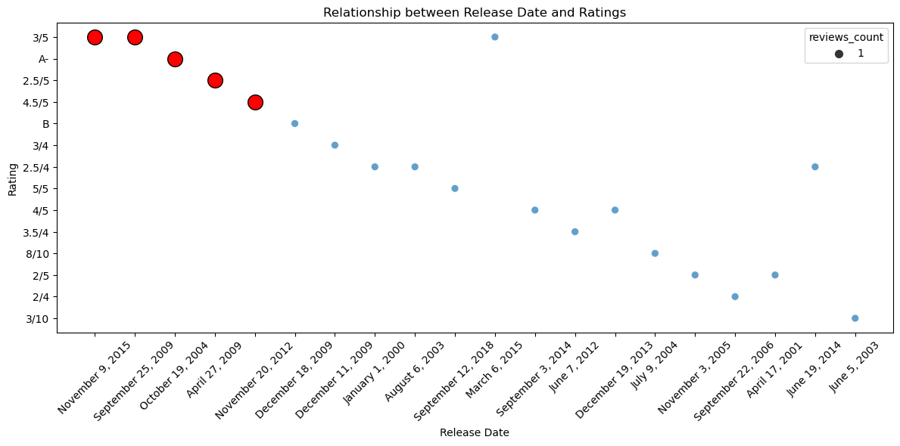
QUESTION ONE GRAPH

Slide 9
QUESTION TWO
In question two I followed the same directory as question one
I used movie_csv_df
The dataframe consist columns eg: ‘popularity’, ‘genre_ids’, ‘title’
The question answered :the below arguments:
-check the movie title with the highest vote_count
-check the movie title which was the most popular
-checked the ratings of the movie title

Slide 10
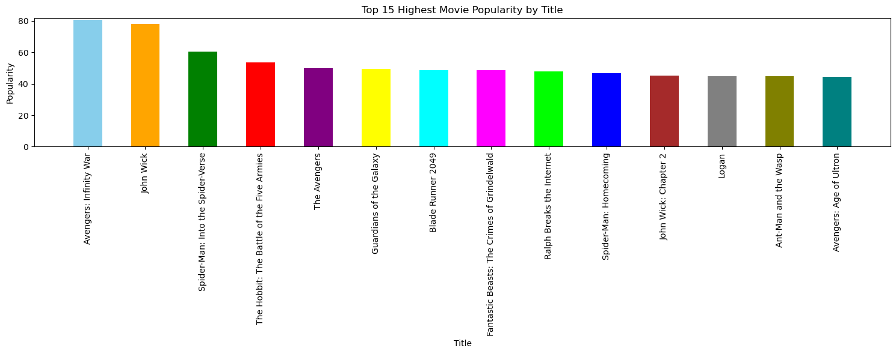
QUEESTION TWO GRAPH

Slide 11
QUESTION THREE
- in the above question I used the movie_budgetcsv_df
The dataframe consists of the below colums:
- ‘worldwide_gross’,’ production_budget’ , release date
The answered the below arguments:
- calculate the profit margin
- show the relationship between profit and budget
- relationship between release date and budget.

Slide 12
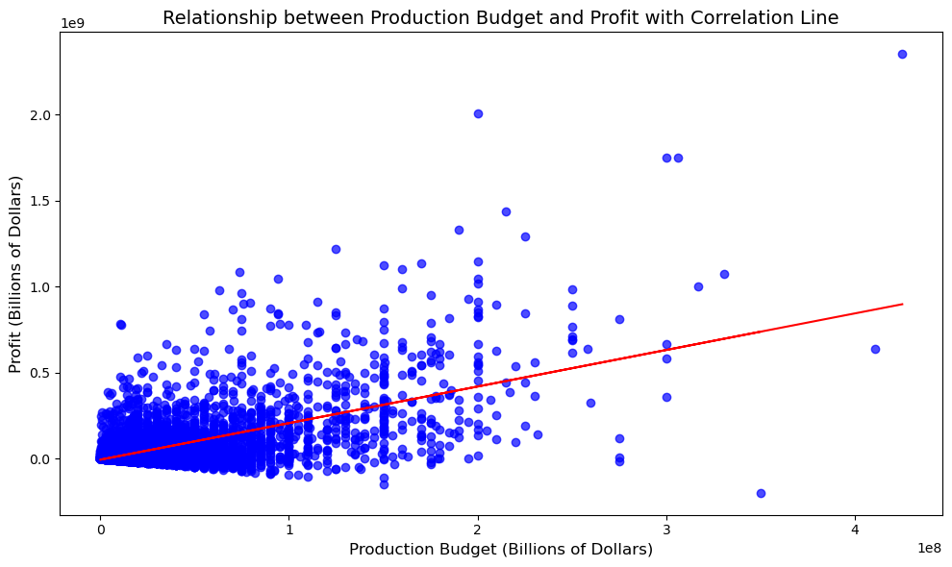
QUESTION 3 GRAPH

Slide 13
RECCOMENDATIONS
to release movies during the last three months of the year.
to hire publishers with the high rating for the movies,
to choose a movie title that will be popular and get a high vote_count
i would advise they allocate a budget that is good enough to yeild high profits

Slide 14
DATA SCIENTIST DETAILS:
ESTHER MUKAMI NJAGI
LINKEDLN PROFILE: Esther Mukami

